Slide 1


Spreadsheet software
Formatting

Slide 2
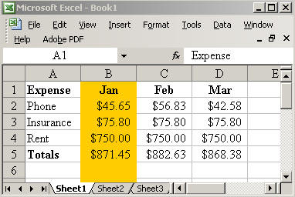
Revision - terminology
Think, pair, share
Discuss the meaning of the following terms with the students around you, then report back to the class.
Formula
Function
Cell range
Statistical functions
Logical functions
Workbook
Worksheet
Efficiency

Slide 3
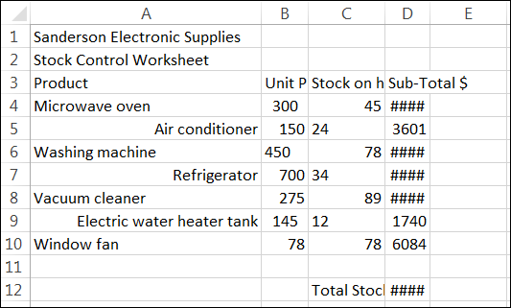
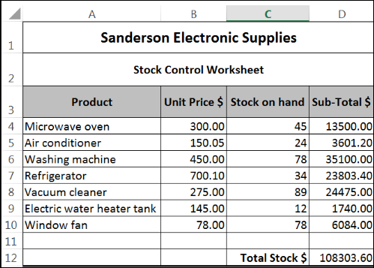
Spreadsheet formatting
Formatting is changing the appearance of data and information stored in a spreadsheet.
Formatting is important because:
It makes the information easier to understand
It allows important information to stand out
It makes the information look more professional

Slide 4
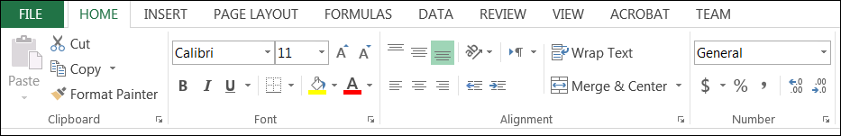
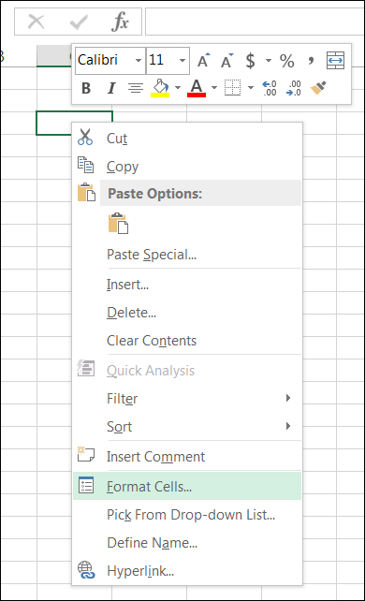
Formatting features
Some of the basic methods used to format a spreadsheet include:
Resizing columns and rows
Adding columns and rows
Changing font types/size/colours
Changing cell background colours
Aligning text and numbers
Much of the formatting can be completed using the icons on the Home toolbar.
Another formatting tool is the Format Cells feature. Right click in any cell to bring up the menu.

Slide 5
Activity: Formatting a spreadsheet
1. Download the formatting spreadsheet from eLearn.
2. Format the spreadsheet so it looks the completed version shown.

Slide 6
Activity: think, pair, share
Think
Think of the methods that you used to format the spreadsheet.
Pair
Demonstrate the methods you used achieved the results that you did.
Discuss whether you achieved the finished result using different methods.
Share
Share your findings with the class.

Slide 7

Spreadsheet conventions
Conventions are rules of formatting that are normally followed.
Most types of information products follow conventions when created.
When we write a letter using word processing software, what are some rules of formatting that are followed?

Slide 8


Spreadsheet conventions
Each type of information product will have formatting rules that are normally followed when creating the product.
Think of other conventions normally applied to information products.

Slide 9
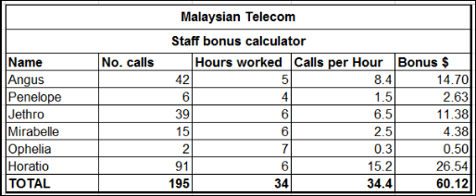
Spreadsheet conventions
Conventions that are often applied to a spreadsheet include:
Text left aligned
Numbers right aligned
Where numbers have decimals, the number of decimal places must be consistent (e.g. 0, 1 or 2 decimal places)
All currency values ($) must have 2 decimal places
Headings and sub-headings must be bold
Measurements (e.g. $, %, KG, KM) must be included in the column header and not in individual cells

Slide 10
Activity: Spreadsheet conventions
Download the conventions spreadsheet from eLearn.
Apply conventions to the spreadsheet so it looks like the spreadsheet shown.
Think, pair, share
Think
What to you think are the benefits of applying conventions to a spreadsheet?
Pair
Discuss the benefits with the students sitting around you.
Share
Report your findings back to the class.

Slide 11
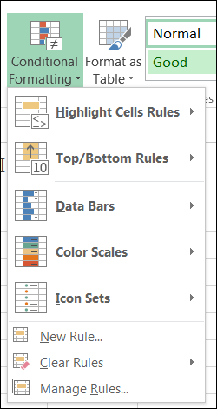
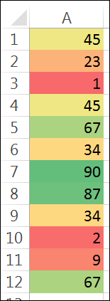
Conditional formatting
Conditional formatting is a feature of spreadsheet software that formats each cell depending on the value of the cell.
It is used to highlight cells that contain values which maybe important or significant.
The conditional formatting icon appears on the Home toolbar.

Slide 12
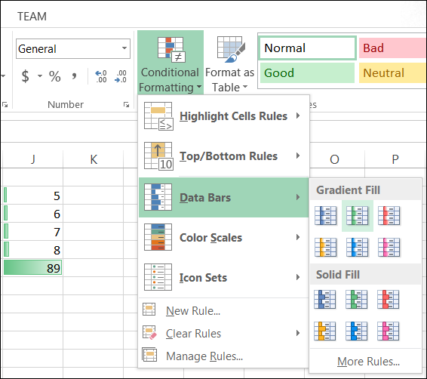
Conditional formatting
Conditional formatting methods include:
Pre-set conditions
The easiest method is using one of the pre-set conditions including:
Data Bars
Colour Scales
Icon Sets
Simply highlight the cells to be formatted and select one of the pre-set options.

Slide 13
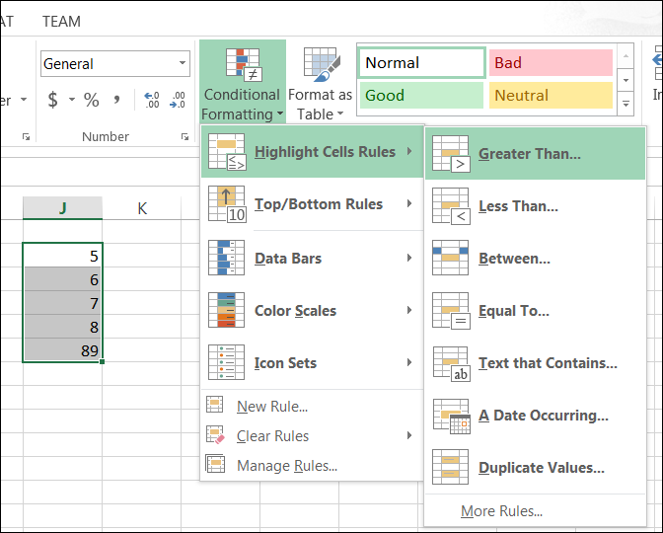
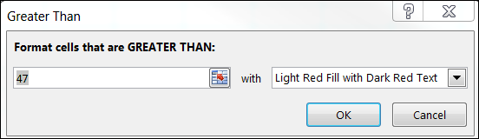
Conditional formatting
Conditional formatting methods include:
Pre-set rules
These are pre-programmed rules for commonly used conditions.
They include:
Highlight Cells Rules
Top/Bottom Rules
Select the cells then select the pre-set rule type.
Then the arguments of the rule can be edited.

Slide 14
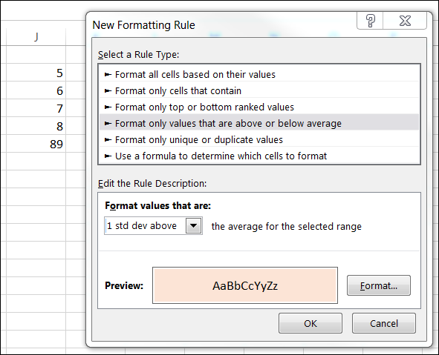
Conditional formatting
Conditional formatting methods include:
Rules
Rules can be created to set conditions for formatting that do not already exist in one of the pre-set options.
Select the cells, then select new rule.
Chose the type of rule to apply, the conditions and the type of formatting.
Up to three rules can be applied to a range of cells.

Slide 15
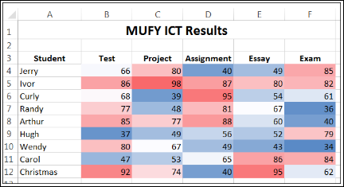
Activity - Conditional formatting
Download the conditional formatting spreadsheet from eLearn.
Apply a range of conditional formatting methods including:
Pre-set conditions
Pre-set rules
Rules
3. Think, pair, share.
Think
Where could you use conditional formatting?
Pair
Discuss your situations with the students on your table.
Share
Share your findings with the class.

Slide 16

Write workbook notes
Complete workbook notes on page 3:
Conditional formatting
Conventions
Formatting

Slide 17

Post-class activity
Complete the multiple choice quiz on eLearn after class today.

